Slide 1
SNVC Corporate Capabilities

Slide 2
Company Profile
Mature Small Business providing technology services to our warfighters and other government departments for over 22 Years.
Woman-Owned and Service-Disabled Veteran-Owned
CVE Certified- Aug 2019.
Extensive customer and technical expertise
Performed services on over 125 different task orders as a prime
Understand government laws and regulations
Exceptional CPARS ratings
We measure our service delivery results and find ways to improve performance and create value for the customer
Which all means…
Exceptional Performance
Under Budget
On Time
With Seamless Integration with Operations

Slide 3
Program and Policy Support Capabilities
• Program Management
• Project Management
Life-Cycle Management
• Army Policy and Regulations Staffing
Cyber Policy and Exercise Management
• Business Process Management
• System Integration
“Efficient and Exceptional”
This is how our clients describe our program and project management services. We develop long-term business solutions to meet your goals on time and within budget. We find business efficiencies outside the contract scope. We measure the risk of implementing new business strategies to maximize your return.
Each partnership is guided by an experienced Project Manager with expertise matched to your specific requirements. These leaders are vested with decision-making authority to minimize project lag time while ensuring your program complies technically and contractually with industry standards. Each Project Manager is supported by a team dedicated to contract satisfaction and customer success.

Slide 4
Network and Cyber Defense Operations Capabilities
Design and Architecture
Security Engineering
Risk Management Framework (RMF)
Command Cyber Readiness Inspections (CCRI) Support
Service Desk Operations
Hardware Maintenance and Support
Firewall and Switch Configuration
Disaster Recovery and Contingency Planning
Enterprise Software Management and Operating System Deployment
“Reliable and Rock Solid”
Whatever the network type, operations must be reliable, effective and secure . In today’s wartime environment, unreliable networks create information disruptions or make data vulnerable. Neither are acceptable to us.
The stability of our Wide and Local Area Networks echoes the maturity of the company. With our experience comes the expertise necessary to deliver quality, security and state-of-the-art network operations support. Our customers trust us to construct and maintain infrastructure enabling secure communication and the smooth flow of information. We support national security networks reaching US interests around the world and provide the information backbone for instructors delivering critical training to our warfighters.

Slide 5
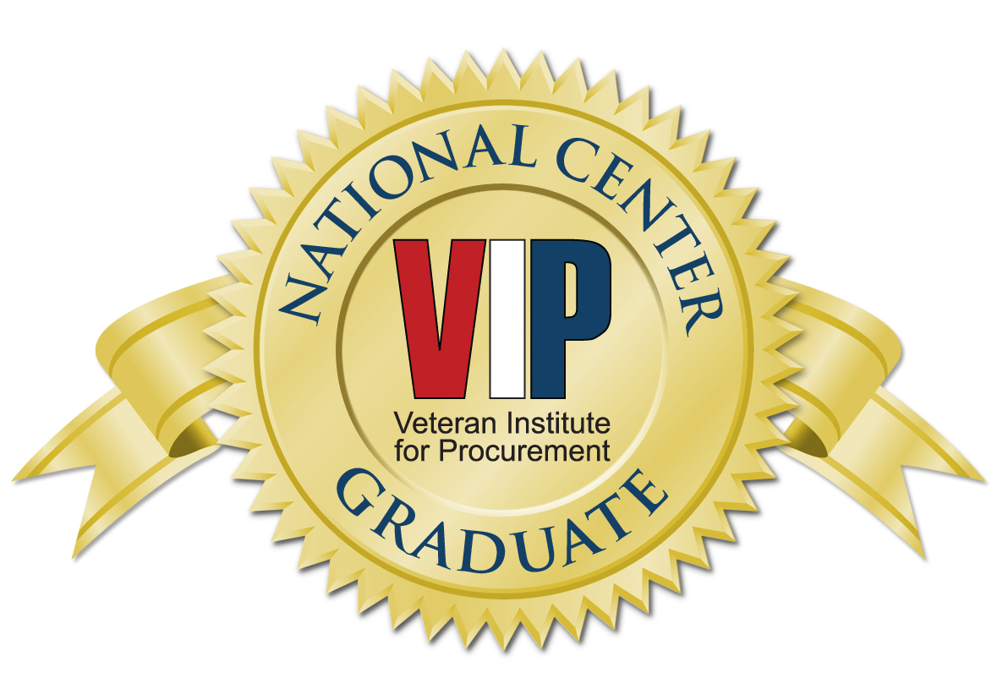
Company Information
Company Information
Facility Security Clearance: Top Secret
CAGE: 1F4Z6
DUNS Number: 041320164
Primary NAICS
541330 – Engineering Services
541512 – Computer System Design
541513 – Computer Facilites Management Services
541519 – Other Computer Related Services
541611 – Administrative Management and General Management Consulting Services
Recognitions and Awards
2011 and 2012 Virginia Business Magazine winner of the “Best Places to Work” award, ranked as the #1 Northern Virginia company to work for in the 100-250 employee category in 2012.
The company was recognized as an Inc. 500 fastest growing company as well as one of the Virginia Fantastic 50. SNVC was also recognized by GSA as the Best Innovative Small Business.
We are a past member of the Virginia Chamber of Commerce and led the VA Chamber of Commerce Small Business Committee.
The owners of SNVC are both veterans and we
value our veteran employees.

Slide 6
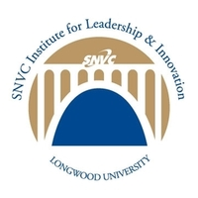
Our Commitment to Service
Established by SNVC from 2008-2019
As a nonprofit 401(3)(c)
SNVC Institute for Leadership & Innovation at Longwood University
Funded by SNVC in 2010
Teaches leadership curriculum based on the teachings of Stephen R. Covey’s 7 Habits of Highly Effective People
Director, Dr. Paul Barrett, won a literary award from Emerald Publishing in 2020 on how leader development results in better leaders
www.longwood.edu/business/snvc/
Aurora’s Mission is now Complete! To enable veterans to successfully graduate from college and enter the workforce
Provided grants of $200,000 which helped support 36,000 student veterans in 36 colleges and universities nationwide
Funded 38 internships in multi-disciplines to veteran students, of which 100% made successful transitions from graduation to the workforce

Slide 7
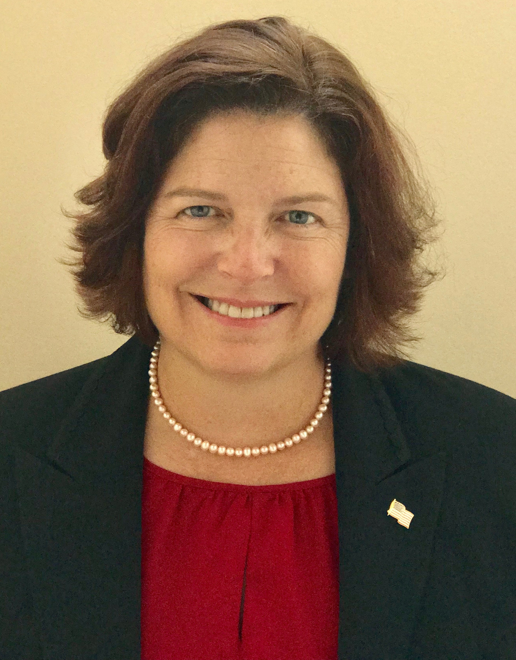
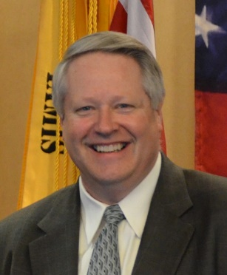
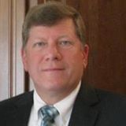
Contact Information
Claire Cuccio, PhD
President and CEO
Claire.Cuccio@SNVC.com
Tom DeWitt
Executive Vice President
Tom.DeWitt@SNVC.com
Reggie Williams
SVP, Service & Delivery
Reginald.Williams@SNVC.com
Carl Pearson
Director, IT
Carl.Pearson@SNVC.com
Headquarters: 1700 Stuart Pointe Ln, Herndon, VA 20170
www.SNVC.com
703-952-7682

